Slide 1

Data On Internationally-Educated Physicians in Canada
2011 IMG Symposium
Monday 17 October, 2011
Toronto, Ontario, Canada
Steve Slade, VP, Research and Analysis CAPER-ORIS
Linda Bourgeois, Research Associate
Canadian Post-MD Education Registry
Association of Faculties of Medicine of Canada

Slide 2
Evolving IMG-IEP Context
Many people, organizations, complex processes
Balancing need for physicians with public safety
Standards of Canadian vs. international medical schools (accreditation, curriculum, graduate preparedness, etc.)
Growing domestic and international demand for UGME and PGME in Canada
Ethical recruitment and treatment of IMGs

Slide 3
Evolving IMG-IEP Context
Canadian Task Force on Licensure of IMGs - 2004
  Increase capacity to assess IMGs
  Work toward standardization
  Expand/Develop programs to support IMGs
  Develop capacity to track and recruit IMGs
  Develop a national research agenda
Notes:
3

Slide 4
Evolving IMG-IEP Context
More recently:
  Agreement on Internal Trade- Chapter 7- Labour Mobility
  Framework for Foreign Credential Recognition
  National Regulatory Coordination
    Physician Credentials Repository of Canada
    Application for Medical Registration in Canada
  National Assessment Collaboration
Notes:
4

Slide 5
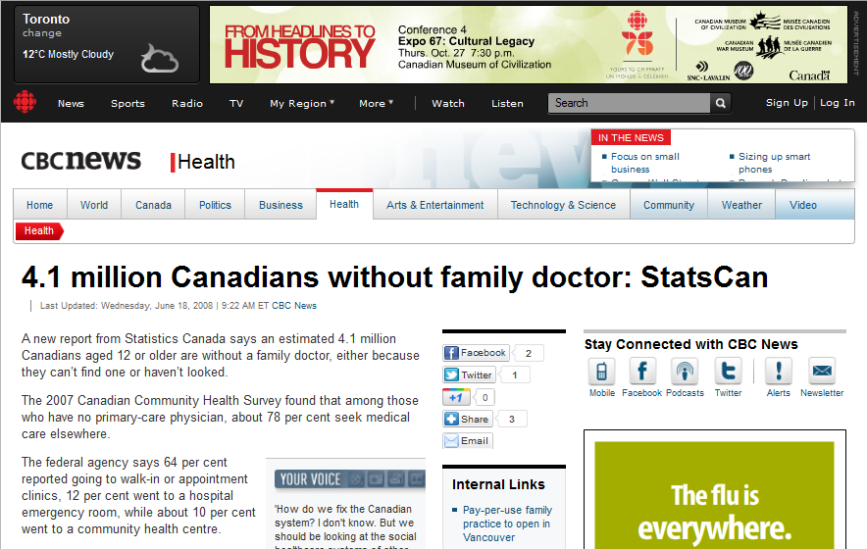
Data in an Evolving Context
Physician to Population Ratio – Canada Vs. OECD Average

Slide 6
Data in an Evolving Context
Physician to Population Ratio – Canada Vs. OECD Average

Slide 7
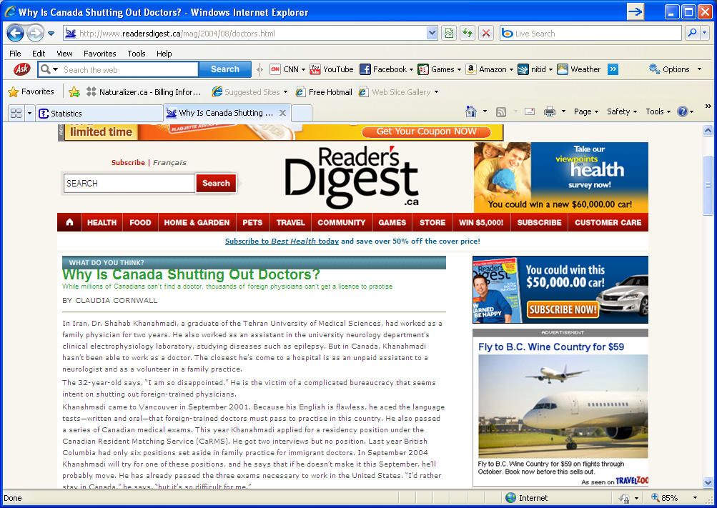
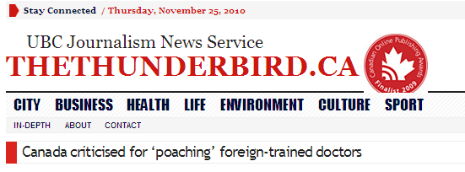
Data in an Evolving Context
Number of IMGs in the Active Physician Workforce, Canada, 1994-2008

Slide 8
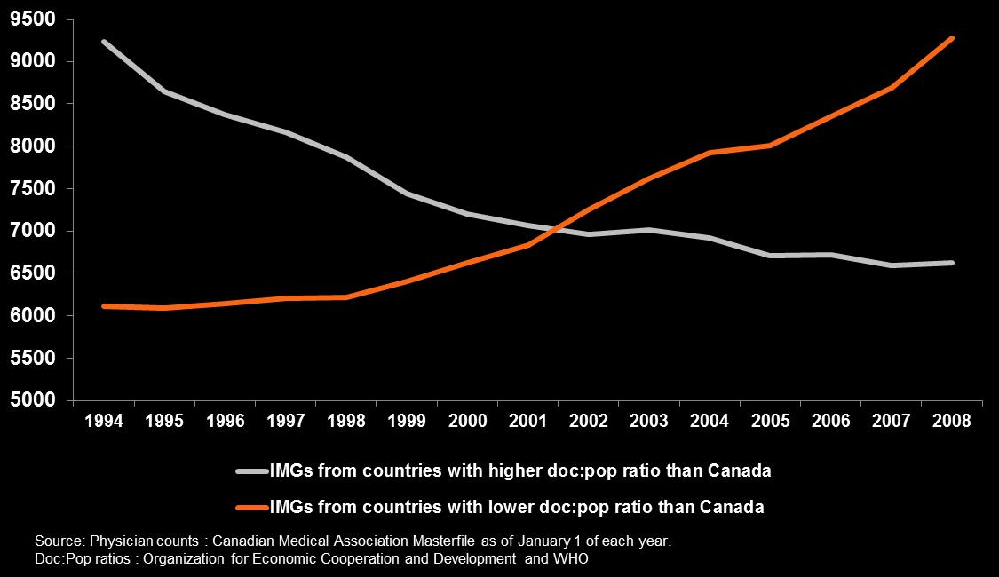
Data in an Evolving Context
Number of IMGs in the Active Physician Workforce, Canada, 1994-2008

Slide 9
Data in an Evolving Context
Increased MD Program Applicants Per 100K Population

Slide 10
Data in an Evolving Context
Increased First Year MD Program Enrolment

Slide 11
Data in an Evolving Context
Increased Number of First Year Post-MD Trainees
Source: CAPER, AFMC, 2010. Note: Excludes visa trainees.

Slide 12
Data in an Evolving Context
Increased Number of Clinical Teachers

Slide 13
IMGs in Canada Project
National IMG Database

Slide 14
The IMGs in Canada Project:
Brief History
Key Task Force Recommendations (2004)
  Develop capacity to track and recruit IMGs
  Develop a national research agenda
Phase I: 2005-2009
  Foundational activities
Phase II: 2010-2013
  Maintain, enhance, create, support
  User guided
Notes:
14

Slide 15
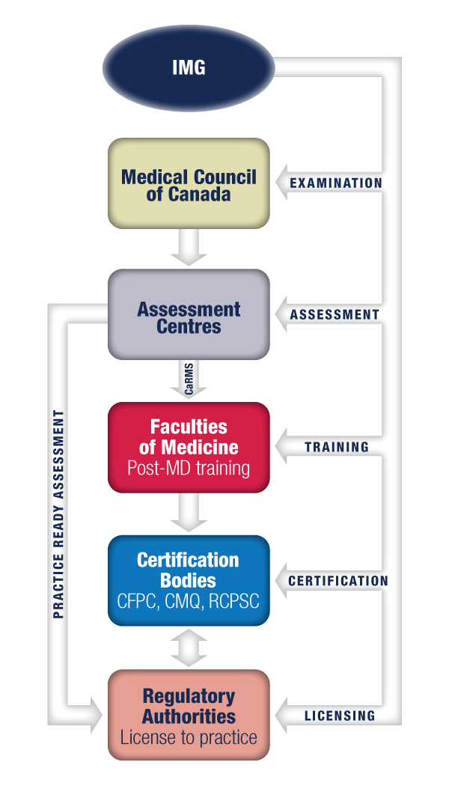
National IMG Database
Data Collection Framework
Medical Council of Canada (MCC)
7 IMG assessment centres
17 Faculties of Medicine
The College of Family Physicians of Canada (CFPC)
The Royal College of Physicians and Surgeons of Canada (RCPSC)
Collège des médecins du Québec (CMQ)
9 regulatory authorities

Slide 16
National IMG Database
Current Data Status – Exam, Training, Certifying Bodies

Slide 17
National IMG Database
Current Data Status - Assessment Centres

Slide 18
National IMG Database
Current Data Status – Medical Regulatory Authorities

Slide 19
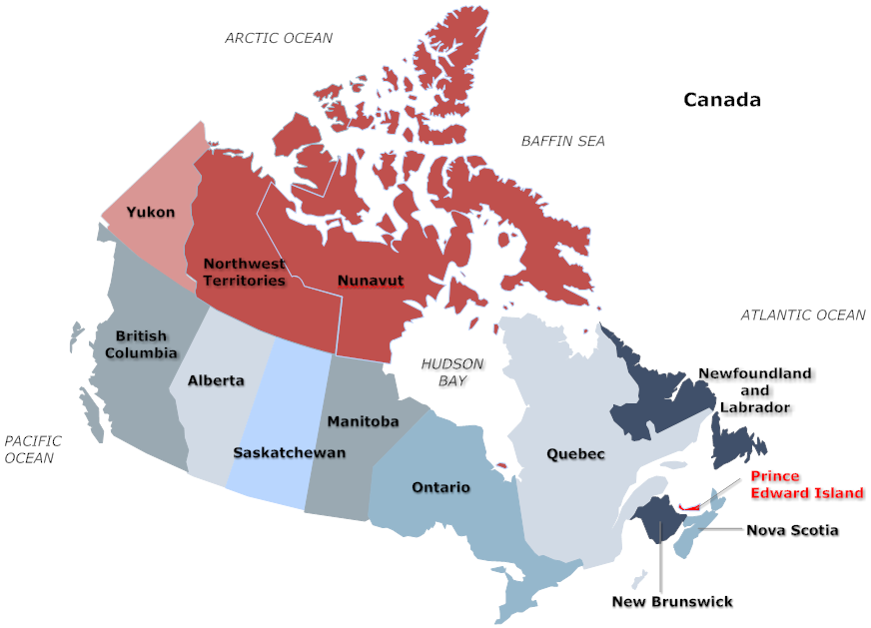
National IMG Database
Current Data Status – Missing MRAs
Non-participants:
Prince Edward Island
Health And Social Services, Government of Northwest Territories
Health And Social Services, Government of Nunavut
Aggregate Data:
Yukon Medical Council as of Sept 1, 2010

Slide 20
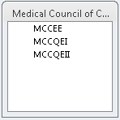
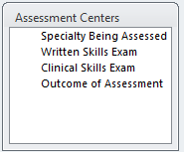
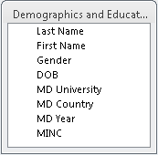
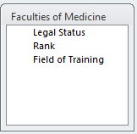
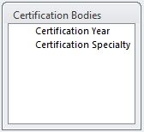
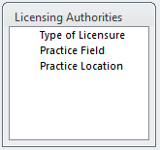
Sample of Data Variables Collected
Requested Data Variables

Slide 21
IMGs in Canada
Emerging Picture from the National IMG Database

Slide 22
Cumulative Number of Distinct IMGs in the National IMG Database
Most are non-Citizens, writing the Evaluating Exam overseas and/or training in Canada under Visa status.
Source: National IMG Database, 2011

Slide 23
Number of IMGs who passed MCC Examinations, by Self-Reported Citizenship, 2005-2009
Source: IMG Database, 2010.
Note: Citizenship is self-reported by IMGs and not necessarily source-verified.

Slide 24
Number of IMGs who passed MCC Examinations, by Birth Country, 2005-2009
Source: IMG Database, 2010

Slide 25
Number of IMG Assessments in Canada, 2005-2009
Source: National IMG Database, 2010

Slide 26
First Year Post-MD IMG Trainees

Slide 27
Number of IMGs Certified by College of Family Physicians of Canada, Royal College of Physicians and Surgeons of Canada, College des Medecins du Quebec, 2006-2009
Source: IMG Database, 2010

Slide 28
Number of IMGs Certified by College of Family Physicians of Canada, Royal College of Physicians and Surgeons of Canada, College des Medecins du Quebec, 2006-2009
Excluding Visa Trainees
Source: IMG Database, 2010

Slide 29
Number of First-Time Licenses Issued to IMGs By Medical Regulatory Authorities, 2005-2009
Source: IMG Database, 2010.
Note: “All Other” includes provisional, temporary, academic, locum and other types of non-full licenses.

Slide 30
Following the Progress of a Cohort of Canadian Citizen IMGs
2005-2007
MCC EE
1491
2005-2009
Post MD training
411
Assessment Centre
218
Certifying Body
97
Regulatory Authority
77
62
2
35
Source: IMG Database, 2010
Notes:
62

Slide 31
Cohort Progress to Post-MD Training
Entry to Post-MD Training | Gender | Number | Average Age (years)
No | Female | 558 | 39.59
 | Male | 522 | 38.87
No Total |  | 1080 | 39.24
Yes | Female | 185 | 36.52
 | Male | 226 | 35.57
Yes Total |  | 411 | 36.00
Grand Total |  | 1491 | 38.35
Source: IMG Database, 2010

Slide 32
Cohort in Post-MD Training
Gender | PostMD | Total | % of Gender Group | % of Total
Female | Family Medicine | 97 | 52.4% | 23.6%
 | Laboratory | 6 | 3.2% | 1.5%
 | Medicine | 72 | 38.9% | 17.5%
 | Surgery | 10 | 5.4% | 2.4%
Female Total |  | 185 | 100.0% | 45.0%
Male | Family Medicine | 98 | 43.4% | 23.8%
 | Laboratory | 10 | 4.4% | 2.4%
 | Medicine | 87 | 38.5% | 21.2%
 | Surgery | 31 | 13.7% | 7.5%
Male Total |  | 226 | 100.0% | 55.0%
Grand Total |  | 411 |  | 100.0%

Slide 33
Percent of Cohort Entering Post-MD Training, By Country of MD Graduation
Source: IMG Database, 2010.
Note: Countries with >=10 IMGs in MCC EE 2005-2007 cohort.

Slide 34
Percent of Cohort Entering Post-MD Training, By School of MD Graduation
Source: IMG Database, 2010.
Note: Countries with >=10 IMGs in MCC EE 2005-2007 cohort.

Slide 35
Cohort With Full or Provisional License
Licensed
(Full or Provisional)
77
Certification
(CFPC/RCPSC/CMQ)
35 (46%)
QEII
(Not Certified Yet)
23 (30%)
QEI
(No Cert, No QEII Yet)
9 (12%)
No Cert, QEs, Assessment
10 (13%)
? Provisional
? Data Timeframe
? Missing Data
31 QEI & II
23 QEI
7 Assessment
4 Assessment
2 PGME
43/77 (56%) PGME

Slide 36
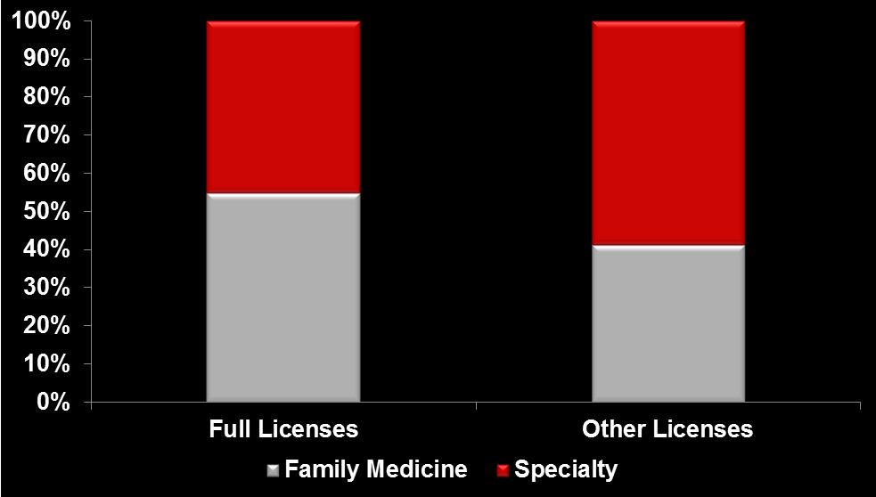
License Status by Field of Practice
Source: IMG Database, 2010.

Slide 37
Practice location at 2 and 5 years after PGME graduation, 2000-2004
IMG
CMG
Source: CAPER Database, 2010

Slide 38
Distribution of Licensed IMGs in Urban/ Rural Canada
Source: IMG Database, 2010.

Slide 39

Thank you
This project is funded by the Government of Canada's Foreign Credential Recognition Program.

